Slide 1
Customer Churn Prediction
Anurag V, DSBA – Oct,2020

Slide 2

Business Problem
Objective & Constraints
Exploratory Data Analysis
Model Building
Insights & Recommendations

Slide 3
Business Problem
There is an E-commerce company facing a lot of competition in the current market scenario & it has become challenging to retain existing customers. It’s more cost effective to retain existing customers than to acquire new ones, which is why it’s important to track customers at high risk of churning out and target them with retention strategies. We need to develop a churn prediction model & provide some business recommendations.

Slide 4
Objective & Constraints
Main Objective of this business problem are
To develop a churn prediction model.
Providing valuable insights from the data
Business Recommendations
Major constraints/challenges faced,
Missing Data & Outliers.
Data imbalance.

Slide 5
Exploratory Data Analysis
Original Dataset Consists of 11,260 Observations & 19 Variables.
Around 14 are of continuous & ordinal type and balance 5 are of categorical/object type.
After renaming unwanted attributes, total of 4,361 Null values are present in the dataset & same has been treated using KNN Imputer.
We can see that around 17% of customers have churned, which implies that there is data skewness towards customers who have not churned. Will be applying SMOTE to reduce the imbalance.

Slide 6
Exploratory Data Analysis
Payment Type
Account Segments
Around 72% of customers preferred Debit & Credit Card. Churn rate is more for customers who preferred debit & credit card as their transaction type.
Around 73% of accounts are of Regular Plus & Super type and we have seen that these account segments are having high churn rate when compared to others.

Slide 7
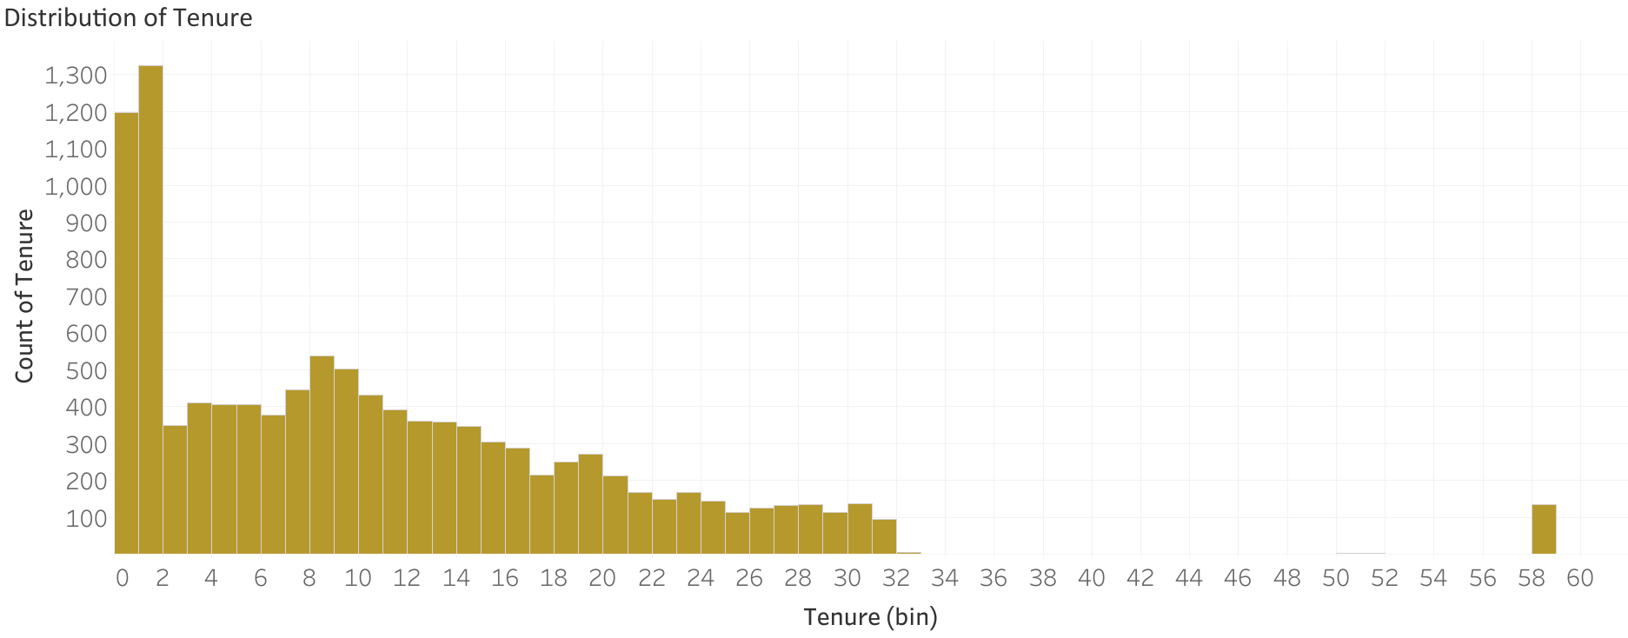
Around 85% of account tenure is less than 20 months, we can see that the data is slightly skewed towards tenure less than 2 months. For other continuous variables there is not much of skewness present.

Slide 8
Model Building
We have opted for 6 models with around 22 combinations, which includes model with hyperparameter tuning, SMOTE etc.
K-Nearest Neighbors
Random Forest Classifier
XG Boost
Artificial Neural Networks
Logistic Regression
Support Vector Classifier
*Hyperparameter tuning done using randomized search cv

Slide 9
Top Five (5) Models
S.No | Model Name & Combination | Train Set |  | Test Set
 |  | Accuracy Score | Recall | Accuracy Score | Recall
1 | KNN with SMOTE & Hyper tuning | 100 | 100 | 93.21 | 96
2 | Random Forest with SMOTE & Default Parameters | 100 | 100 | 96.2 | 90
3 | XG Boost with SMOTE & Hyper tuning | 97.75 | 99 | 93.45 | 87
4 | Random Forest with Default Parameters | 100 | 100 | 96.33 | 82
5 | KNN with Hyper tuning | 100 | 100 | 95.99 | 81
We have shortlisted Top 5 prediction models out of 22 combinations built based on their recall and accuracy score.

Slide 10
Important Features/Variables
From the modelling exercise these are the top 5 features/variables which are important than other variables
Tenure
Account Segment
Days Since Last Connect with Customer care
Cashback
Revenue Growth (YOY)

Slide 11

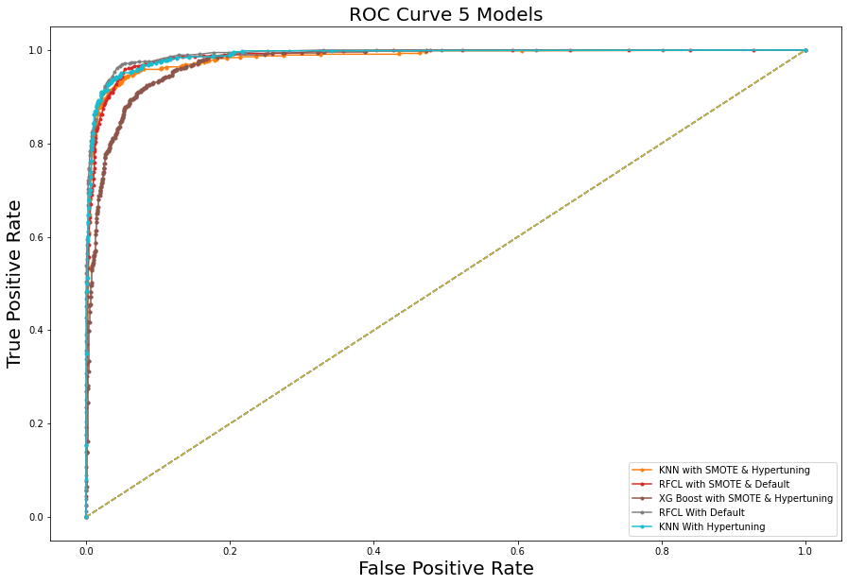
ROC Curve for 5 Models
S.No | Model Description | Test AUC Score
1 | KNN with SMOTE & Hyper tuning | 98.28
2 | Random Forest with SMOTE & Default Parameters | 98.65
3 | XG Boost with SMOTE & Hyper tuning | 99.8
4 | Random Forest with Default Parameters | 99.15
5 | KNN with Hyper tuning | 98.88

Slide 12
Insights & Recommendations
More than 70% of transactions are through Debit & Credit Card. Hence company can tie up with credit/debit card agency for coupons, rewards etc. to attract customers & similarly retain existing customer.
Around 73% of accounts are of ‘Regular Plus’ & ‘Super’ segment. We can see around 20% churn in these segments combined. Company can further look into these segments for any changes in plans or any customization of plans, etc. so that they can reduce the churn rate.
There is around 21% churn in accounts whose tenure is less than 15 months. Hence company can offer them any discounts/offers or suggest them different plans or providing them loyalty programs to retain their account.
Around 12% of customers who didn’t complaint, yet they have churned out which need to be addressed in detail by the company.
More than 20% of customers who have given satisfactory score of 3 & above for customer care provided tend to churn, hence company should focus more on customer complaints, feedback and addressing them with minimum time.

Slide 13
Thank You

